Slide 1


THE EPIDEMIC OF INFLUENCE: UNDERSTANDING DRUG & NICOTINE DEPENDENCY
presented by:
Farham Ahmad-BSDSF24A012
Muhammad Shahab-BSDSF24A032
Umar Shafiq-BSDSF24A050
Husnain Raza-BSDSF24A029

Slide 2
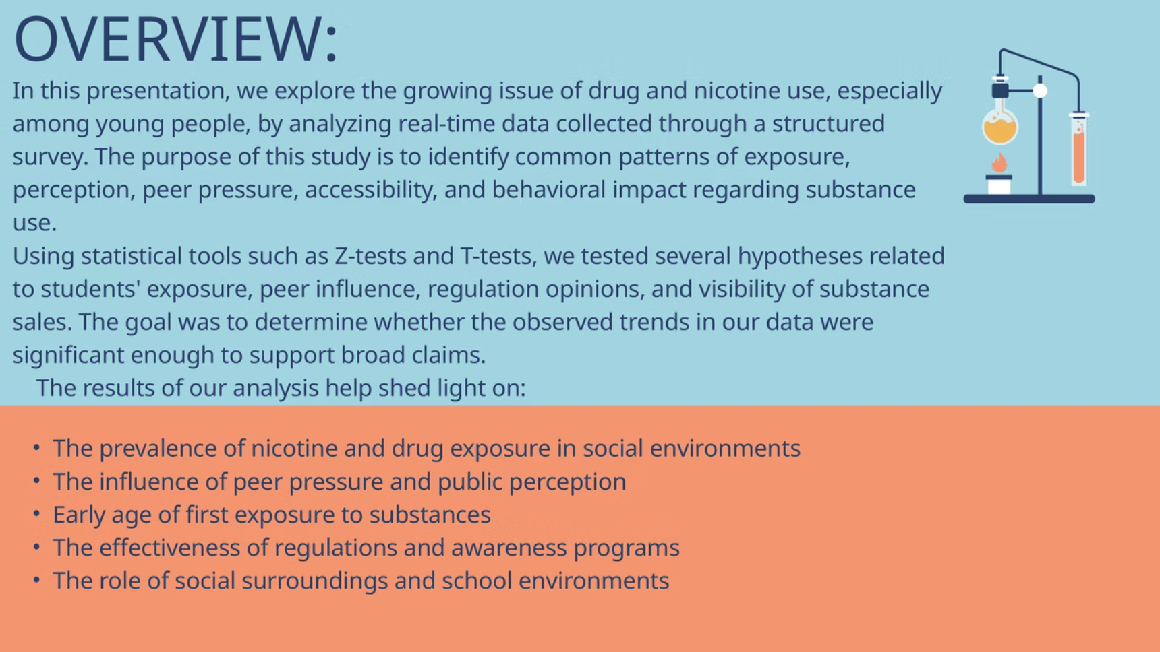

Slide 3
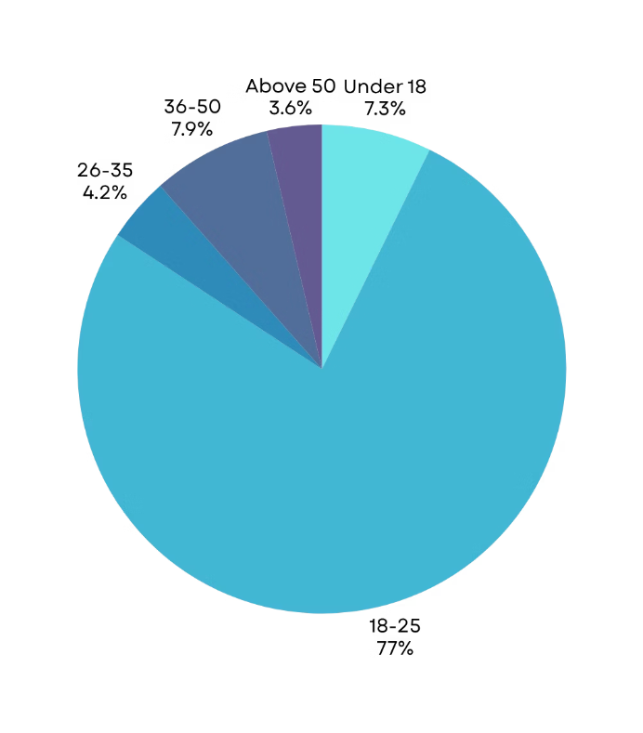


Age Group
Note :
With 77% of the participants falling within the 18–25 age bracket, the findings of this survey are largely reflective of young adult perspectives and behaviors.

Slide 4
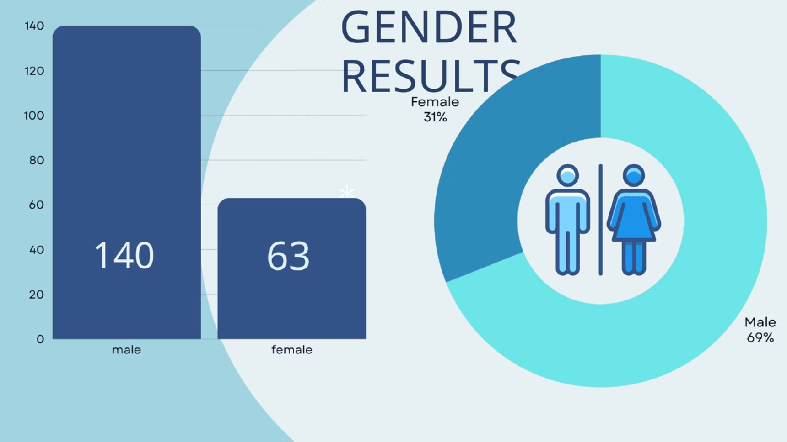

Slide 5
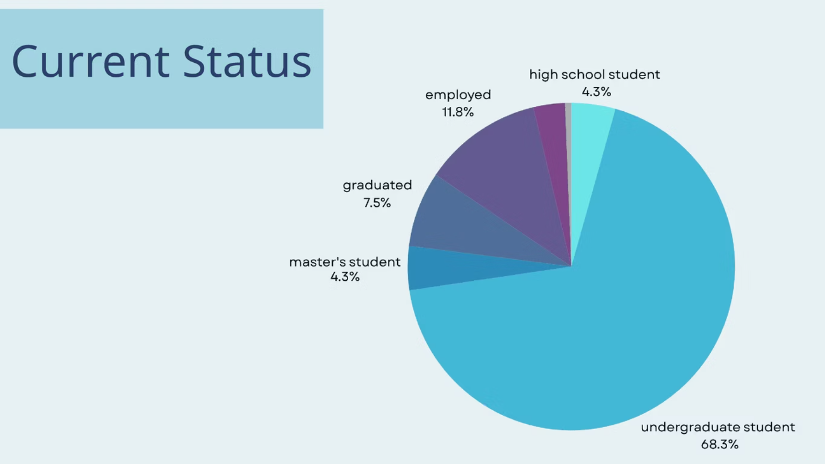

Slide 6

Exposure to Drug/Nicotine Use
Exposure to Drug/Nicotine Use
Sample size: 203
Exposure to Drugs
X = 60 + 51 + 40 = 151 (who are exposed )
n = 203 (size)
ANSWER
Frequency
proportion : x/n
yes, frequently
60
Conclusion:
yes, occasionally
51
The data shows that 77% of participants are exposed to drugs/nicotine use.
Rarely
40
No, Never
49

Slide 7
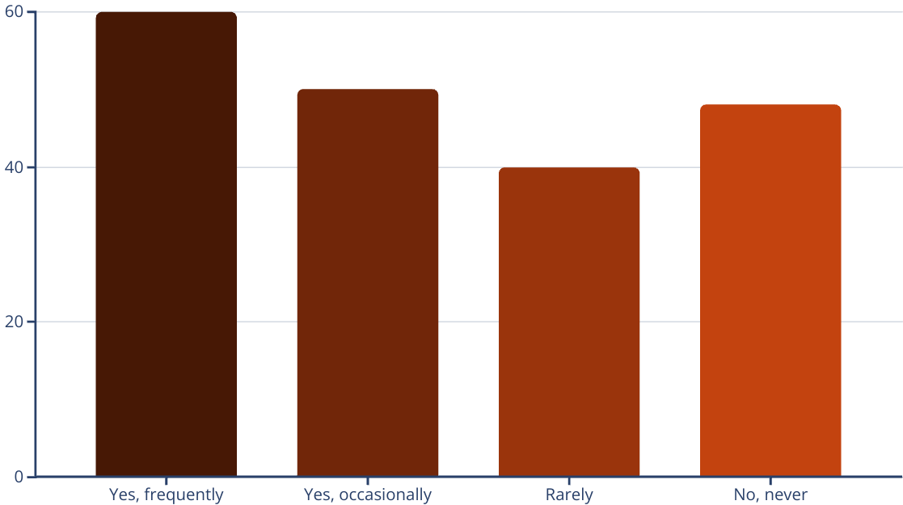

RESULTS

Slide 8

Hypothesis no: 01 Have you ever felt peer pressure to use nicotine or drugs?
H₀: 50% of students did not feel peer pressure.
H₁: More than 50% of students did not feel peer pressure.
Calculation :
Peer Pressure to use nicotine or drugs
H₀ : p = 0.5
H₁: p > 0.5
ANSWER
Frequency
Z = 5.56
yes, often
23
Zₐ = 1.645
yes, occasionally
39
Z > Zₐ
no, never
141
CI = 0.630 < p < 0.759
Conclusion:
We reject the null hypothesis because the calculated Z-value is greater than the critical Z-value.
This indicates that more than 50% of students did not feel peer pressure to use nicotine or drugs.

Slide 9
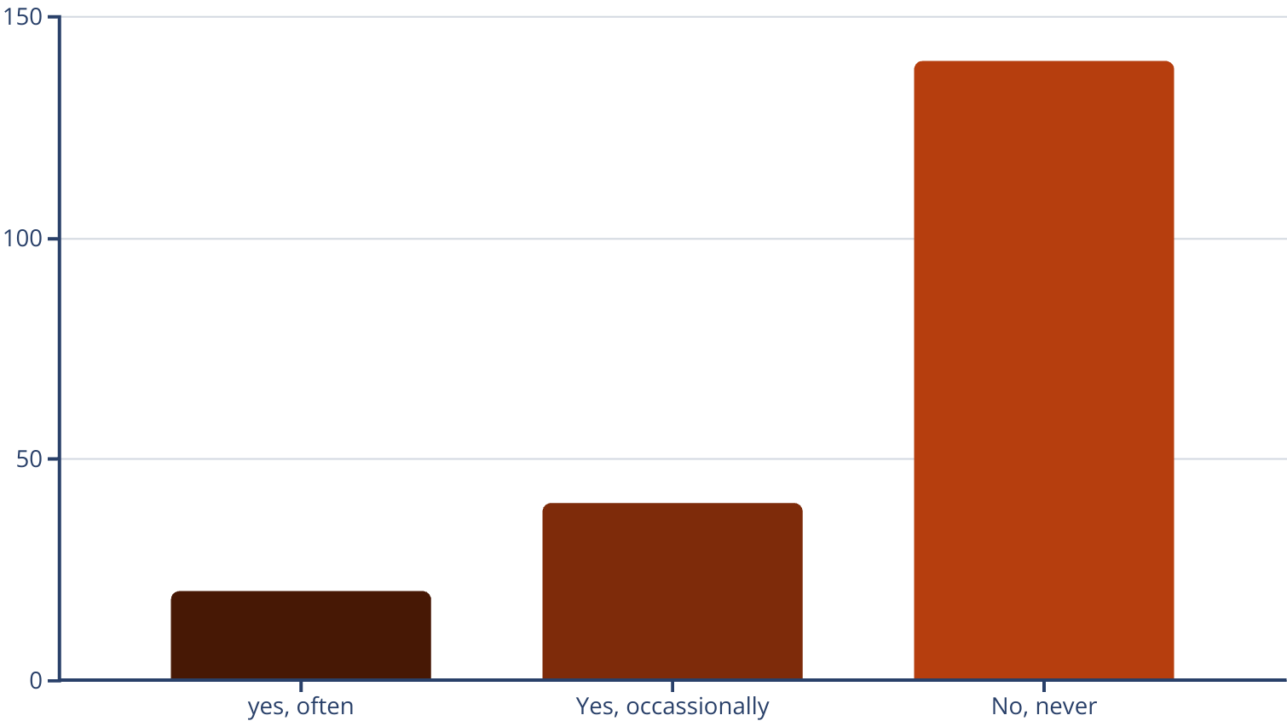

RESULTS :

Slide 10

Peer Pressure to use drugs/nicotine
Sample size: 203
X = 23+39 = 62 (who felt pressure)
n = 203 (size)
proportion : x/n
Conclusion:
Approximately 30.5% of the respondents reported experiencing peer pressure to use drugs or nicotine products.

Slide 11

Hypothesis no: 02 Nicotine Among Youth
Response
Frequency
Score
very common
75
5
somewhat common
60
4
neutral
26
3
Rare
24
2
Not at all
18
1

Slide 12
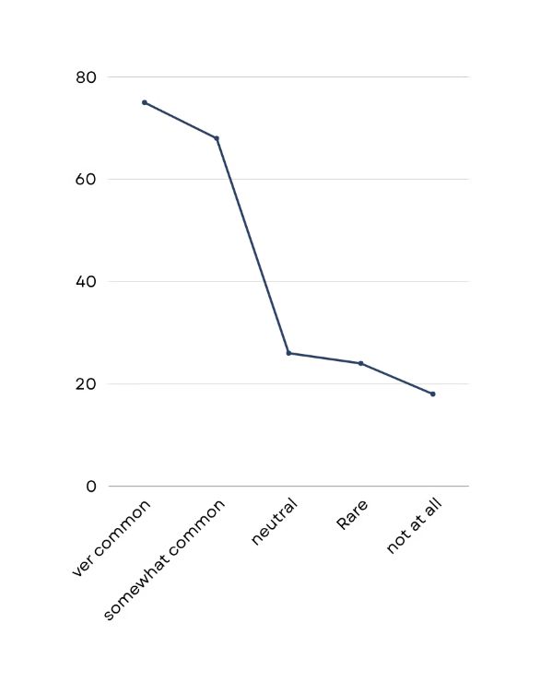

Null and Alternative Hypothesis:
H0 : μ = 3 (Neutral opinion)
H1 : μ > 3 (Vape use is perceived as common)
Calculation :
Sample Mean (x̄) = 3.73
Sample Standard Deviation (s) = 1.31
Sample Size (n) = 203
t = 7.94
ta = 1.652
t > ta
CI = 3.55 < μ < 3.91
Conclusion:
We reject the null hypothesis because the calculated t-value is greater than the critical t-value.
This indicates that vape use is perceived as significantly more common than neutral among young people in the sample.

Slide 13
Hypothesis no 03: Regulation
Support
H₀: 60% support regulation
H₁: More than 60% support regulation
Calculation:
H₀ : p = 0.6
H₁: p > 0.6
Total responses = 203
Support regulation = 105 (complete ban) + 68 (harder access for young people) = 173
Sample proportion (p̂) = 173 / 203 ≈ 0.8522
Standard error = [p(1 - p) / n] = [0.6 * 0.4 / 203] ≈ [0.24 / 203] ≈ 0.001183 ≈ 0.0344
Z = (p̂ - p) / Standard error = (0.8522 - 0.6) / 0.0344 ≈ 0.2522 / 0.0344 ≈ 7.33
Zₐ = 1.645 (for α = 0.05, one-tailed test)
Z > Zₐ
CI = p̂ ± Zₐ * Standard error = 0.8522 ± 1.645 * 0.0344
= 0.8522 ± 0.0566
= 0.7956 < p < 0.9088

Slide 14

Conclusion:
We reject the null hypothesis because the calculated Z-value (7.28) is greater than the critical Z-value (1.645). This indicates that more than 60% of respondents support stricter regulation of nicotine/vape products.

Slide 15
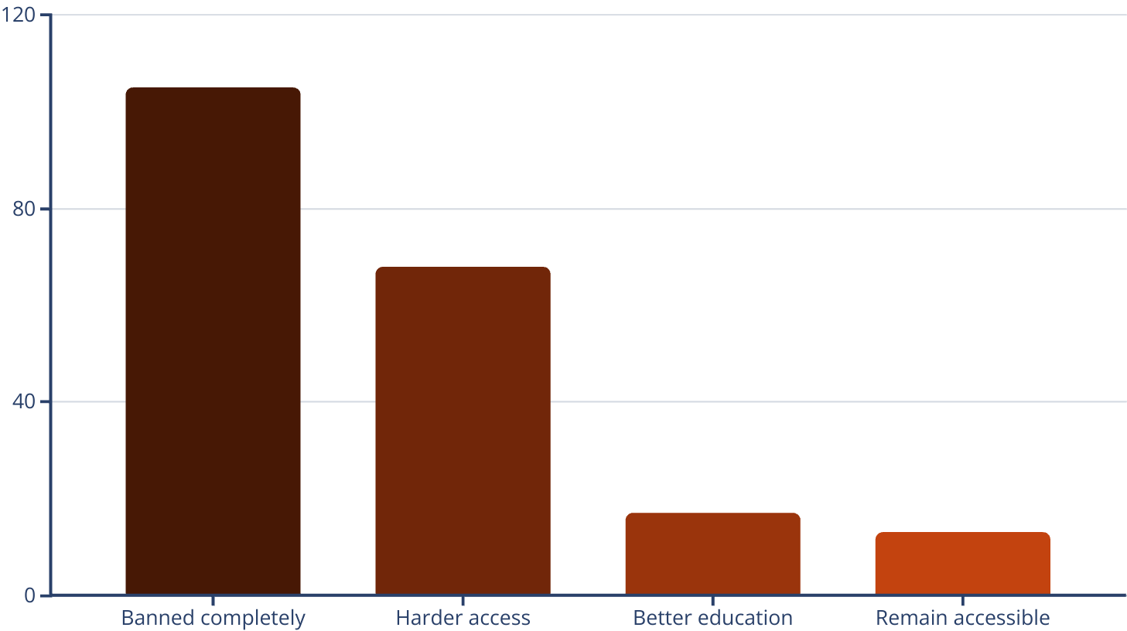
Graphical representation:

Slide 16
SELLING OF NICOTINE /DRUGS
IN YOUR SCHOOL/COMMUNITY
Yes, frequently: 56 / 203 ≈ 27.59%
This breakdown indicates that nearly 56.45%(115/203) have some exposure to sales (frequent or occasional), with a slight majority never witnessing it (43.55%). This could suggest a need for targeted interventions in schools or online platforms, though no formal statistical test is applied here beyond descriptive statistics.
Yes, occasionally: 59 / 203 ≈ 29.06%
No, never: 88 / 203 ≈ 43.35%

Slide 17
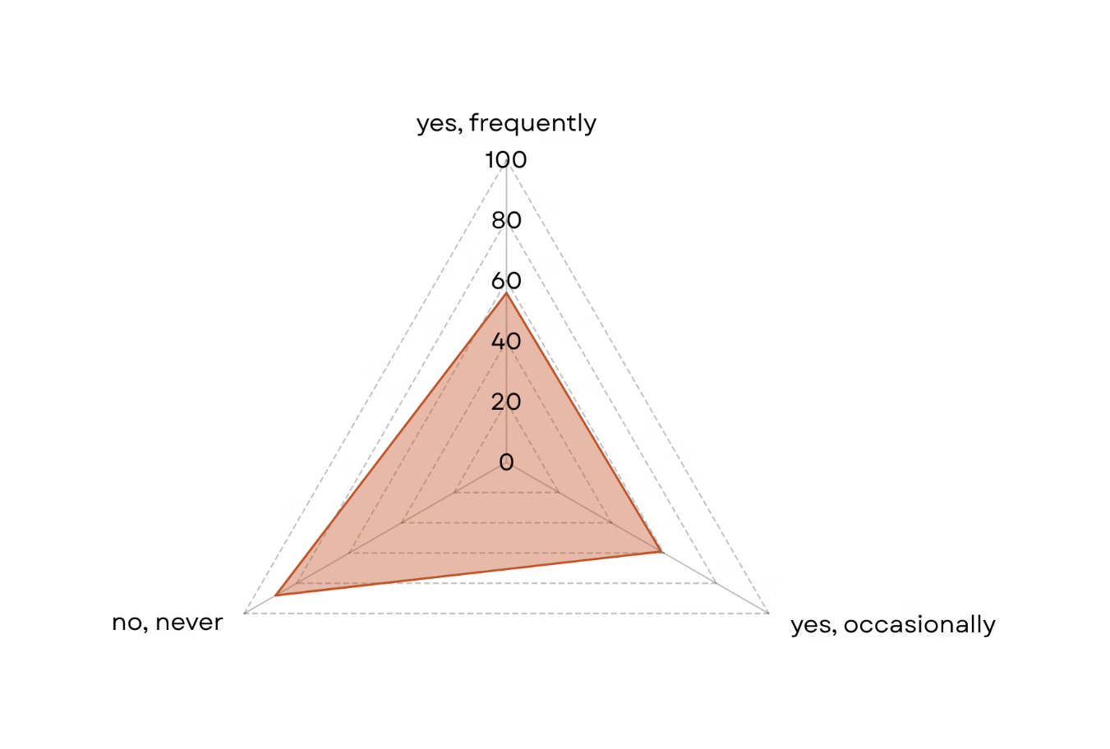

Slide 18
Hypothesis no 04: Nicotine product usage
H₀: 40% or fewer have tried nicotine products
H₁: More than 40% have tried nicotine products
Calculation:
H₀ : p = 0.4
H₁ : p > 0.4
Total responses = 25 + 27 + 45 + 106 = 203
Tried nicotine products = 25 (yes regularly) + 27 (yes occasionally) + 45 (tried once or twice) = 97
Sample proportion (p̂) = 97 / 203 ≈ 0.4778
Standard error = [p(1 - p) / n] = [0.4 * 0.6 / 203] ≈ [0.24 / 203] ≈ [0.001183] ≈ 0.0344
Z = (p̂ - p) / Standard error = (0.4778 - 0.4) / 0.0344 ≈ 0.0778 / 0.0344 ≈ 2.26
Za = 1.645 (for a = 0.05, one-tailed test)
Z > Za
CI = (p̂) ± Za * Standard error = 0.4778 ± 1.645 * 0.0344
= 0.4778 ± 0.0566
= 0.4212 < p < 0.5344

Slide 19
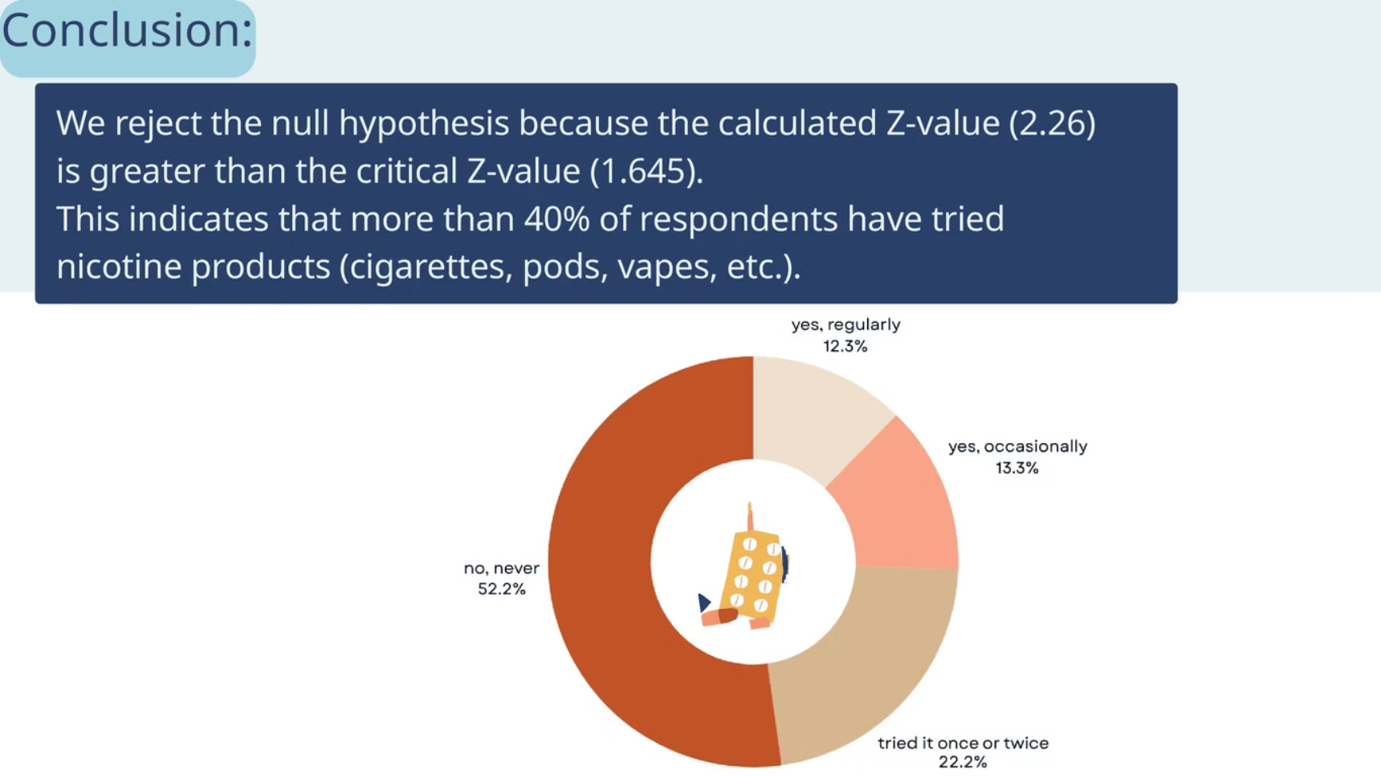

Slide 20
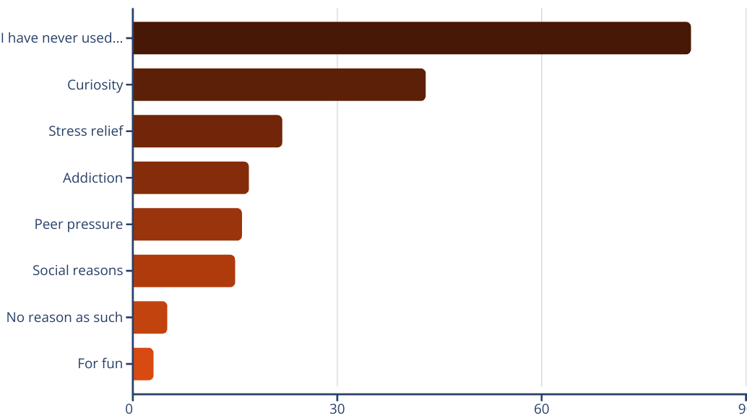

Main reason for trying nicotine products?

Slide 21
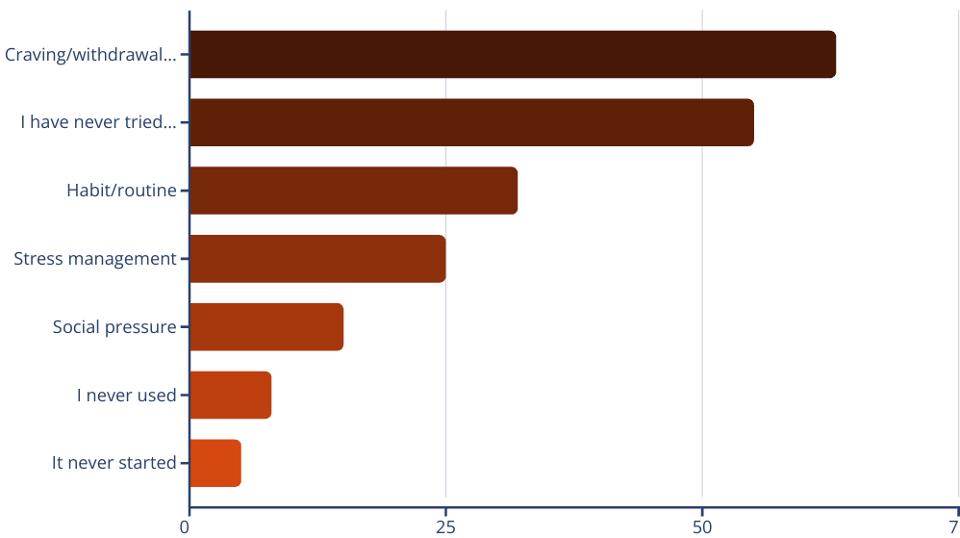

Distribution of Reported Challenges in Quitting Nicotine or Drug Use Among Respondents

Slide 22

Conclusion:
The statistical evidence strongly indicates a significant public concern regarding nicotine and drug use among the surveyed population. With over 85% supporting regulation, 56% observing sales, and 47% having personal experience with nicotine, there is a clear need for intervention to address accessibility, education, and support.
Recommendations:
Strict Regulations
Educational Campaigns
Support Systems
Monitoring and Enforcement

Slide 23

"Thank you for time"
and always
"Say no to drugs"

